Slide 1
Welcome!
EKG Certification Preparation Course Fall 2017

Slide 2
A journey towards a new goal starts with a first step. Today is you’re first step!
Anonymous

Slide 3
Introductions
Justin Hagan – M.S, CCMA, EMT-P
No formal title needed – I am comfortable with just Justin.
Best contact method – via Email.
Justin.Hagan@uky.edu (please allow 24 hours response time)

Slide 4
Course/Syllabus Review
This course will prepare you to sit for the National Healthcare Association - CET (Certified EKG Technician) exam
Will learn to properly apply EKG leads, obtain an tracing, and preliminary interpret/recognize arrhythmias.
Course is 6 weeks long, 2 days a week, 5 hours each day.
Attendance
You must complete 10 successful EKG tracing prior to end of course.

Slide 5
Day 1
Anatomy and physiology

Slide 6
Medical Terminology
Most commonly used and needed to know terms.
Anterior
Posterior
Inferior It would be a good idea to
Lateral start learning these terms.
Myocardium We will be adding on later.
Cardiovascular
Cardiopulmonary
EKG/ECG
Cardio/Cardi

Slide 7
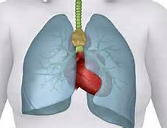
What is our heart?
A hollow Organ
Very Muscular
Closed System
4 chambers

Slide 8
Closed System
4 Chambers
Right and Left
Septum
Pulmonary and Systemic Circulation
4 valves
AV
Semilunar

Slide 9
Chambers and Valves
Right Side
Right Atria
Tricuspid Valve
Pulmonic Valve
Right Ventricle
Left Side
Left Atria
Mitral Valve
Aortic Valve
Left Ventricle

Slide 10
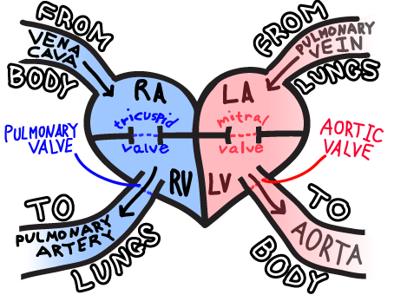
Blood Flow

Slide 11
Heart Layers
Epicardium
Myocardium*
Endocardium

Slide 12
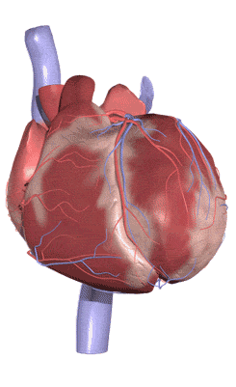
Contraction vs. Relaxation
Contraction
Depolarization
Systole
Relaxation
Repolarization
Diastole
Propagation

Slide 13
Our Heart Cells
Pace Maker
Electrical Conducting
Myocardial
Normal Source
Spontaneous
Initiates
Carrying Current
Left and Right
Largest Tissue Comp.
Heavy Labor
Contraction

Slide 14
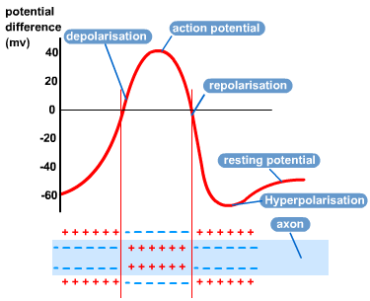

Slide 15
What is needed?
Sodium
Potassium
Calcium*

Slide 16
Sinoatrial Node (SA)
Pacemaker
60-100 BPM
Automaticity
Reacts to Autonomic System
Parahypnotic vs Sympathetic

Slide 17
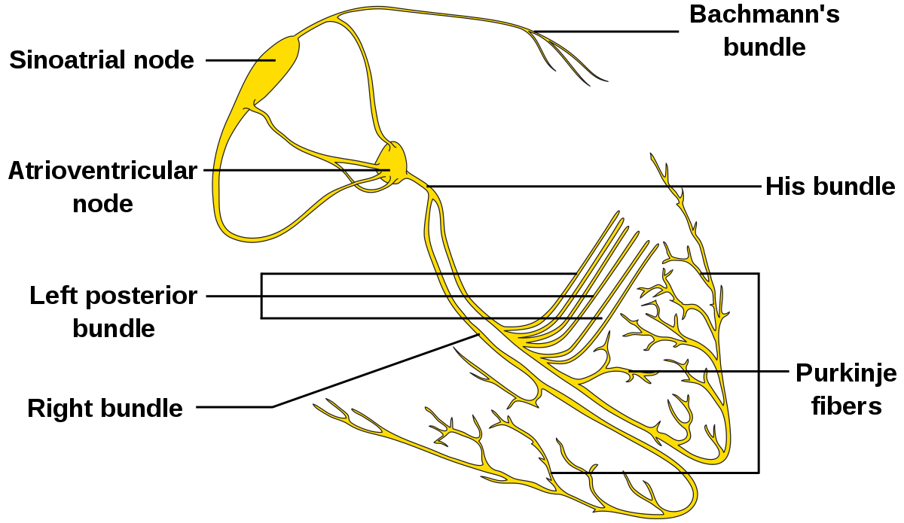
Electrical Conducting Cells (Fibers)
Wires of heart
Perkinje Fibers
Bachmann’s Bundle

Slide 18
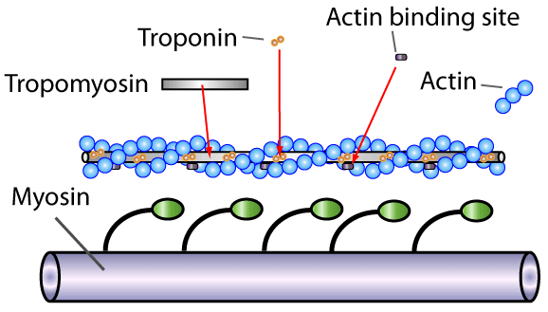
Myocardial Cells
Important Cells
Largest
Ca++ Release
Actin and Myosin

Slide 19
Need a Break?
Take 5 minutes.

Slide 20
What's the Importance?
Basic Understanding
EKG Activity.

Slide 21
Electrocardiogram (EKG/ECG)
Lines
Positive and Negative Deflections
Measurement
Time
Electrical Activity
Configuration (Pathology)

Slide 22
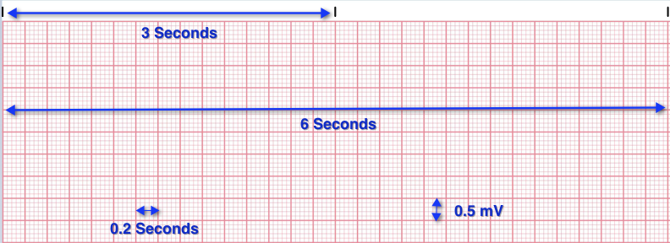

Slide 23
Waves
P wave
Q Wave
R Wave
S Wave
T Wave

Slide 24
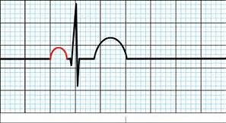
Atrial Depolarization
SA Node
Right/Left
Systole/Diastole

Slide 25
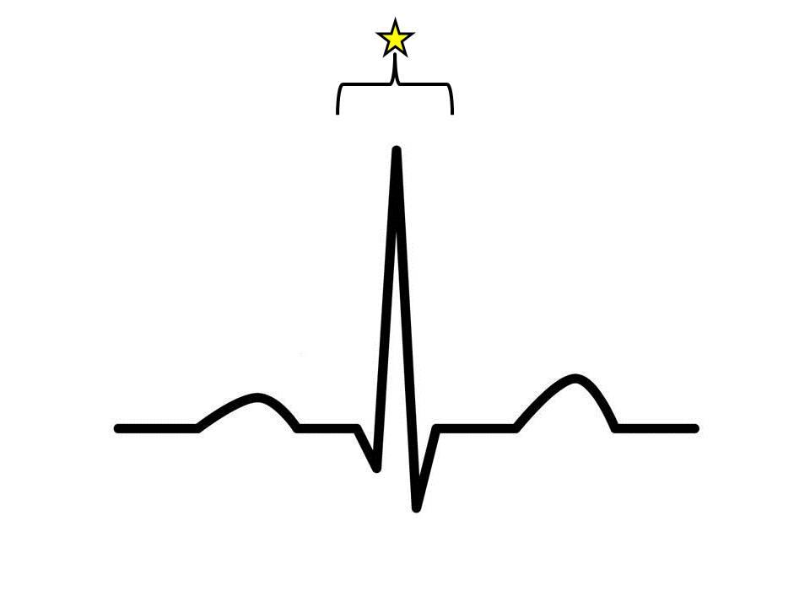
Ventricular Depolarization
Bundle of HIS
Bundle Branches
Purkinje Fibers
Negative (Depolarization again)
Positive
Isometric

Slide 26
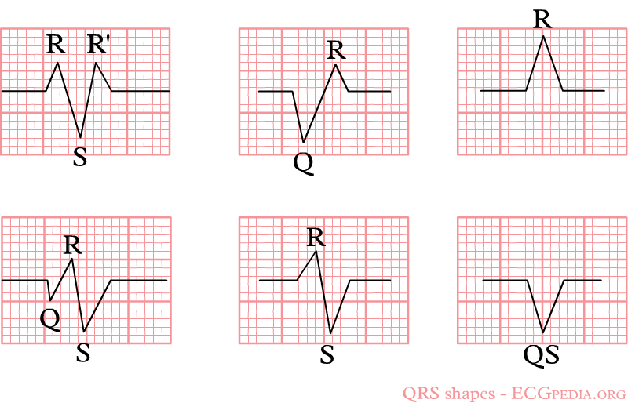
Variations

Slide 27
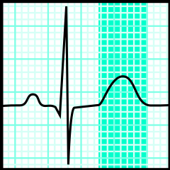
Repolarization
Myocardial
Refractory Period
Electronegativity State

Slide 28
Put it together!

Slide 29
Variations again?
Regular
Regular Irregular
Irregular Irregular

Slide 30
Tracings
Any wave of depolarization moving toward a positive electrode will cause a + deflection.
A wave of deportation moving away from an electrode will cause a – deflection.

Slide 31
Time for another break
Take 5 minutes

Slide 32
Leads (12 lead)
Standard Leads
3
Augmented Leads
3
Limb Leads
6

Slide 33
Vectors

Slide 34
Orientation

Slide 35
Each Lead has a view.
Inferior Leads
Left Leads
Right Leads
Lead II
Lead III
Lead aVF
Lead I
Lead aVL
Lead aVR

Slide 36
Lead Placement
Already know Standard & Augmented Leads
Pericardial Leads?
V leads
Horizontal Plane

Slide 37
V Lead

Slide 38
V Lead Views
Anterior Group
V2, V3, V4
Left Lateral
L1, aVL, V5, V6
Inferior
LII, LIII, aVF
Right Ventricular
aVR, V1

Slide 39
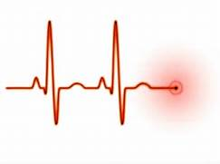
Normal EKG
Waves
Segments
Intervals

Slide 40
Timing is Key!
PR Interval 0.12- 0.20 Seconds
QRS Interval 0.06-0.10 Seconds
QT Interval proportionate to HR

Slide 41
Starting Strong is Good, Finishing Strong is EPIC!
End Chapter 1

